Slide 1
EVP Through Mobile App
Dated: 27.08.19

Slide 2
Platform of EVP System
Electors
UNPER
CSCs
NVSP
VFCs
Electors Verification Programme
(EVP)
ERONET
NCCs/SCCs/DCCs
Voter Helpline APP
Electors
BLONET (BLO APP)
BLOs

Slide 3
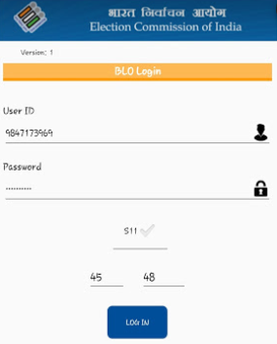
Login Screen

Slide 4
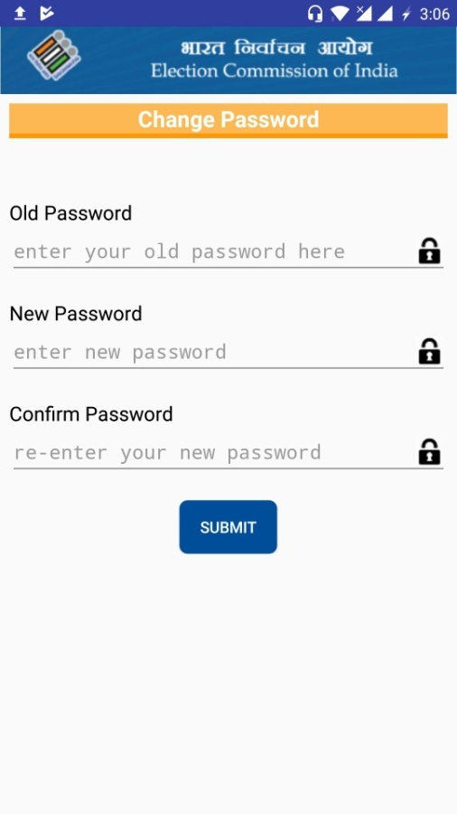
Change Password

Slide 5
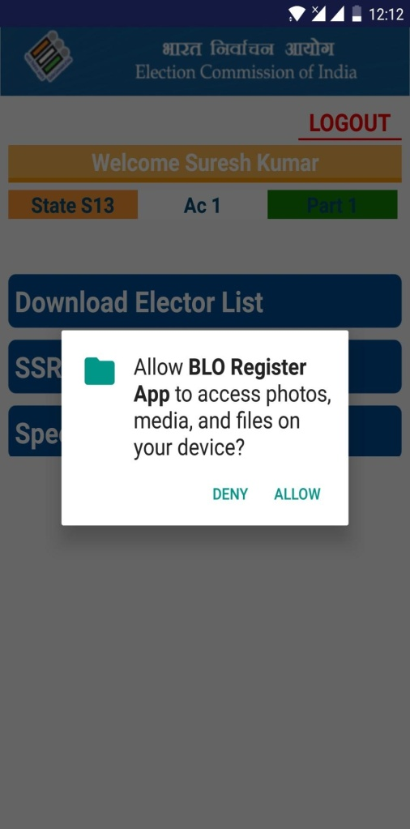
Media Permissions

Slide 6
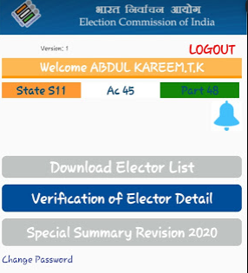
EVP Home Page

Slide 7
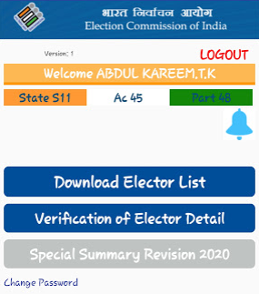
Download Elector List

Slide 8
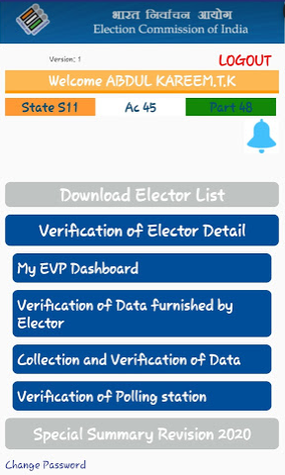
Verification of Elector Detail

Slide 9
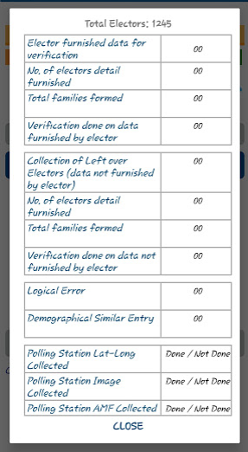
EVP Dashboard

Slide 10
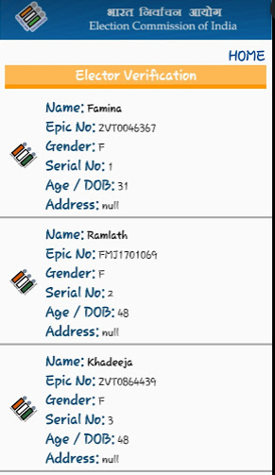
Elector Verification

Slide 11
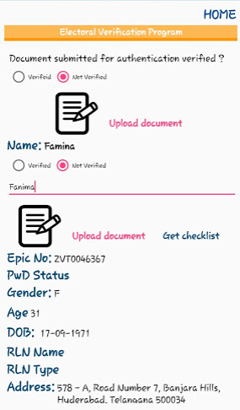
Fields for Elector Verification

Slide 12
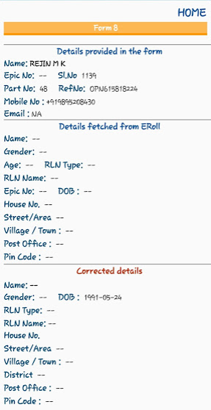
Checklist for Form 8 (Top-Half)

Slide 13
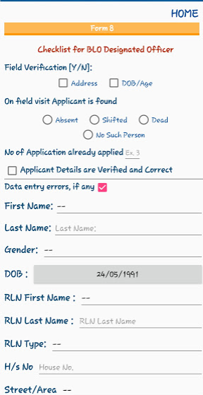
Checklist for Form 8 (Bottom-Half)

Slide 14
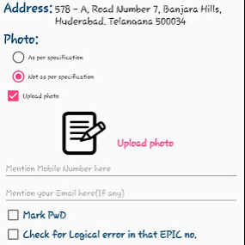
Photo Correction

Slide 15
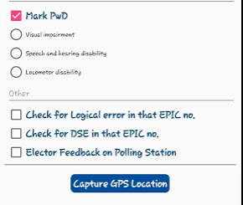
PwD Marking, DSE & LE

Slide 16
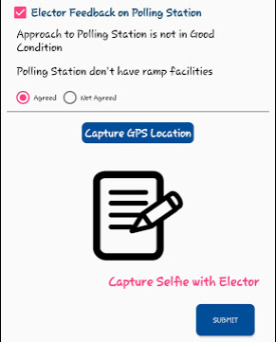
Polling Station Feedback

Slide 17
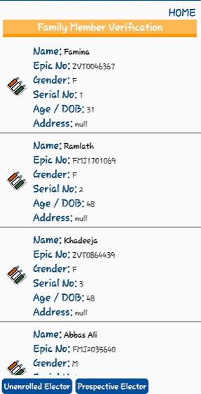
Family Member Verification

Slide 18
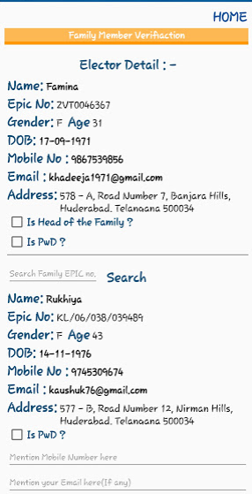
Family Tagging (Top-half )

Slide 19
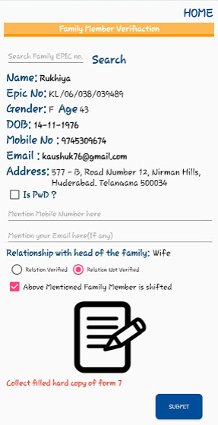
Family Tagging (Bottom-half )

Slide 20
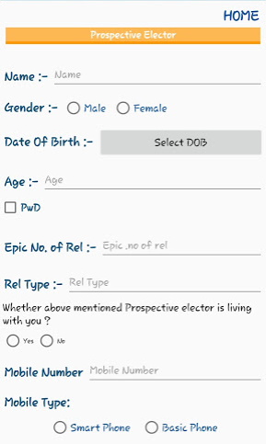
Prospective elector(Top-half )

Slide 21
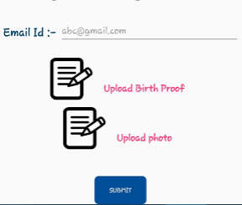
Prospective Elector(Bottom-half )

Slide 22
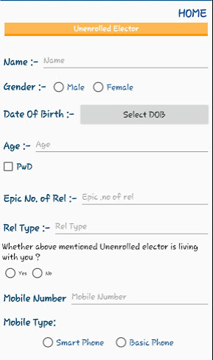
Unenrolled Elector(Top-half )

Slide 23
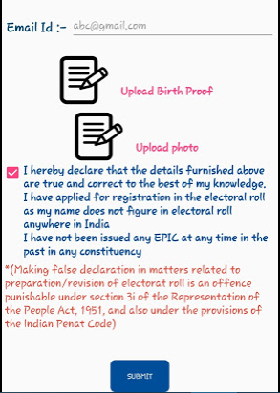
Unenrolled Elector(Bottom-half )

Slide 24
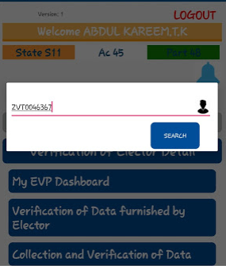
Search by EPIC

Slide 25
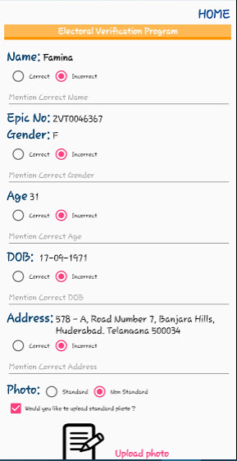
Verification of Details Top half

Slide 26
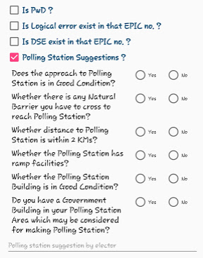
Verification of Details Bottom half

Slide 27
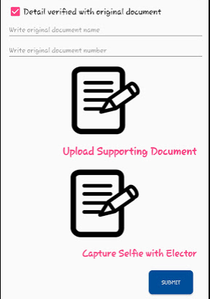
Upload Supporting Document/Selfie

Slide 28
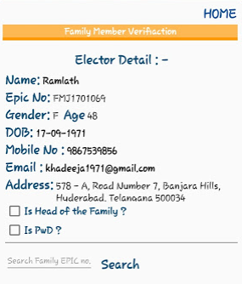
Offline Family Tagging

Slide 29
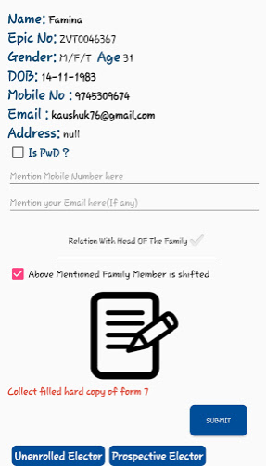
Offline Family Tagging

Slide 30
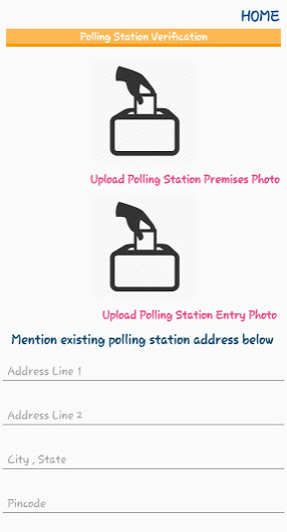
Polling Station details verification

Slide 31
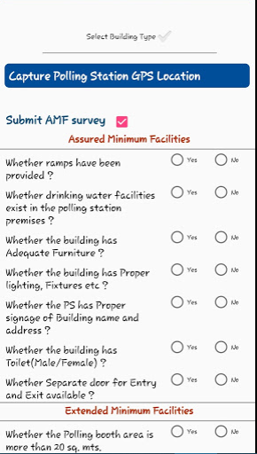
AMF/EMF Details

